Slide 1
Coronary Heart Disease (CHD)
Learning Outcomes
After this section, you should be able to:
describe coronary heart disease in terms of the occlusion of coronary arteries;
list the possible causes of coronary heart disease; and
state possible preventive measures against coronary heart disease.

Slide 2
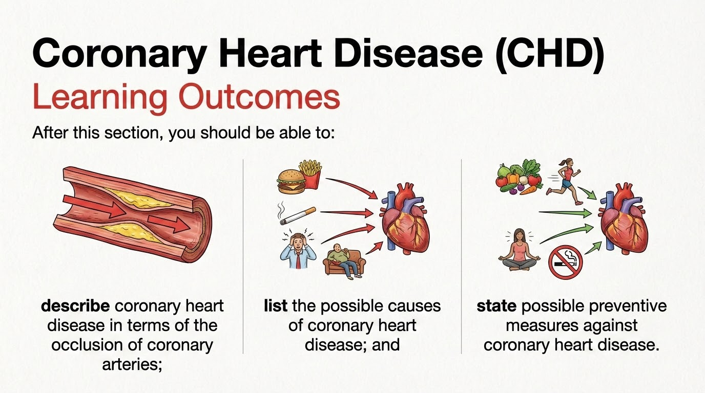

Slide 3
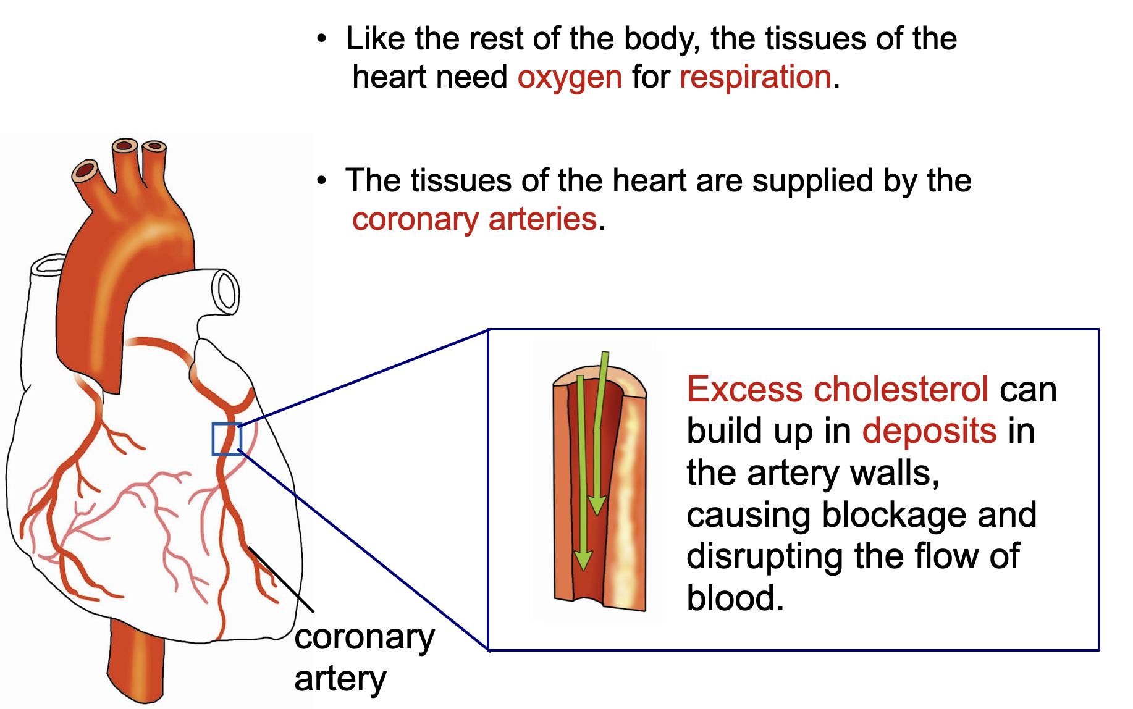
What is coronary heart disease (CHD)?

Slide 4
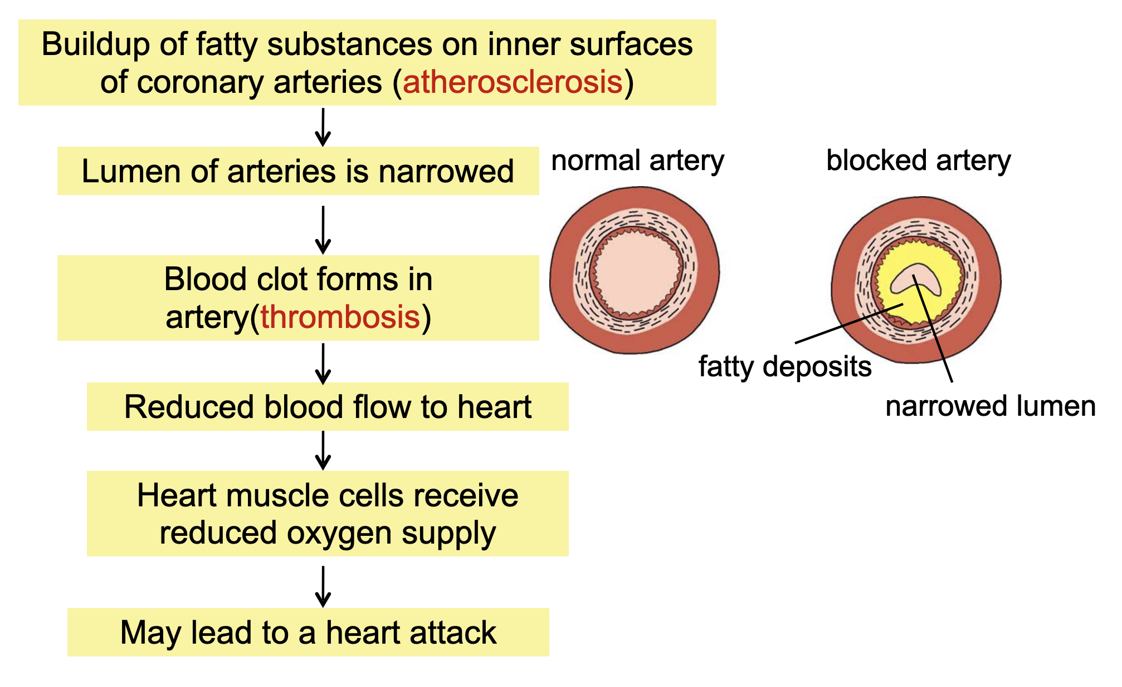

Slide 5
Causes of CHD
A high-fat diet rich in cholesterol and saturated animal fats
Emotional stress
Smoking
Sedentary lifestyle

Slide 6
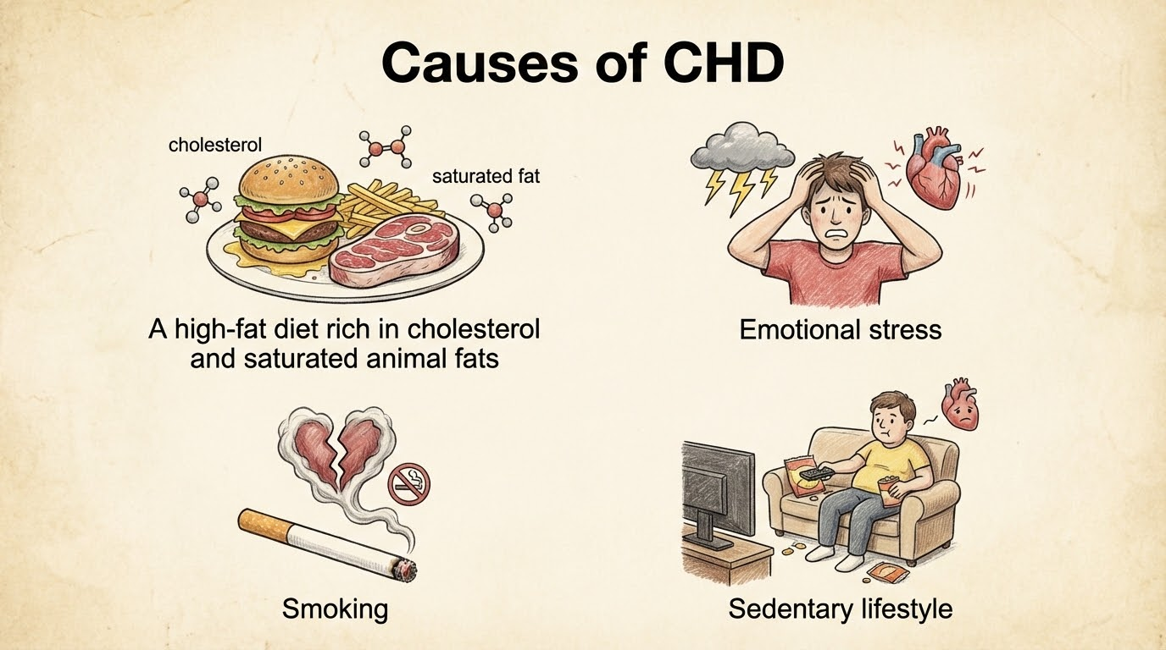

Slide 7
Preventative measures against CHD
A healthy diet:
with reduced intake of animal fats which can be replaced with polyunsaturated plant fats;
rich in vegetables and fruits.
Manage stress in an appropriate way
Avoid smoking
Exercise regularly

Slide 8
